Slide 1
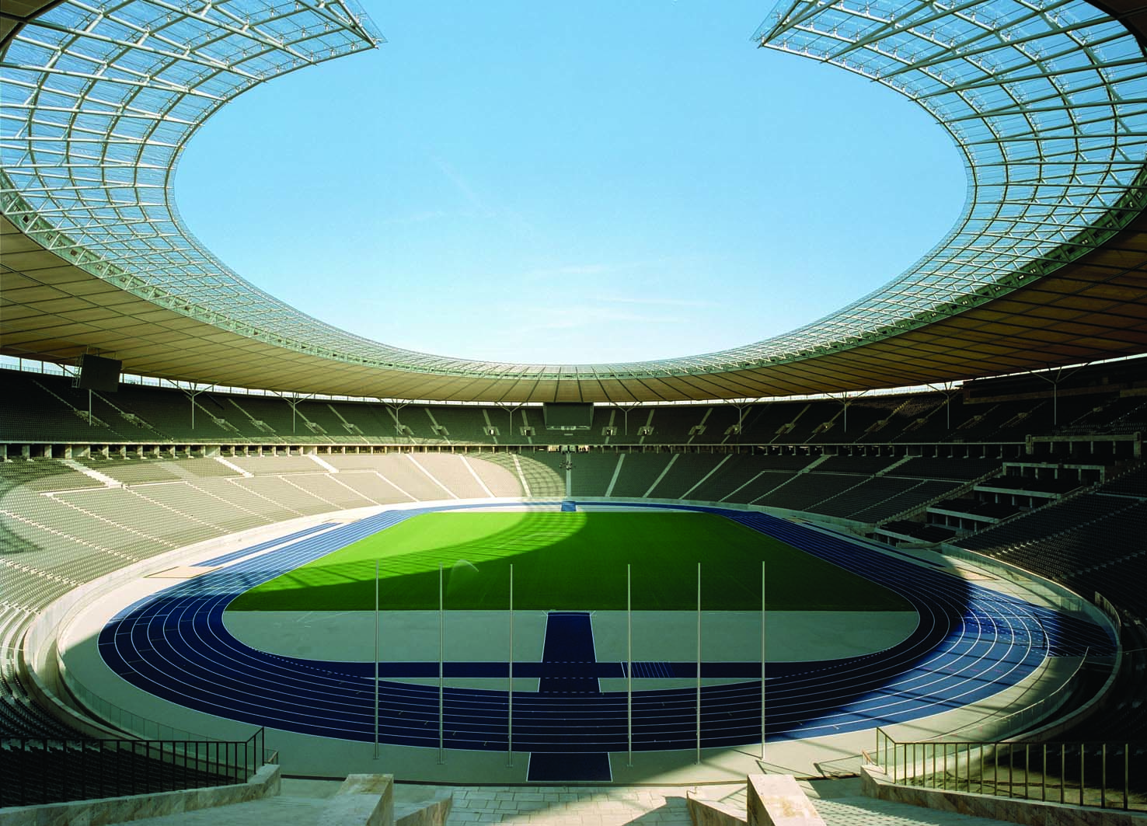
4
THE ECONOMICS OF THE PUBLIC SECTOR

Slide 2
10
Externalities

Slide 3

Figure 1 The Market for Aluminium
Price of
Aluminum
Supply
(private cost)
Equilibrium
Demand
(private value)
0
Q_{MARKET}
Quantity of
Aluminum
Copyright © 2004 South-Western

Slide 4
Figure 2 Pollution and the Social Optimum
Price of
Social
Aluminum
cost
Cost of
pollution
Supply
(private cost)
Optimum
Equilibrium
Demand
(private value)
0
Q_{OPTIMUM}
Q_{MARKET}
Quantity of
Aluminum
Copyright © 2004 South-Western

Slide 5
Figure 3 Education and the Social Optimum
Price of
Education
Supply
(private cost)
Social
value
Demand
(private value)
0
Q_{MARKET}
Q_{OPTIMUM}
Quantity of
Education
Copyright © 2004 South-Western

Slide 6
Figure 4 The Equivalence of Pigovian Taxes and Pollution Permits
(a) Pigovian Tax
Price of
Pollution
P
Pigovian
tax
1.
A Pigovian
tax sets the
price of
Demand for
pollution . . .
pollution rights
0
Q
Quantity of
Pollution
2.
. . . which, together
with the demand curve,
determines the quantity
of pollution.
Copyright © 2004 South-Western

Slide 7
Figure 4 The Equivalence of Pigovian Taxes and Pollution Permits
(b) Pollution Permits
Price of
Supply of
Pollution
pollution permits
P
Demand for
pollution rights
0
Q
Quantity of
Pollution
2.
. . . which, together
1.
Pollution
with the demand curve,
permits set
determines the price
the quantity
of pollution.
of pollution . . .
Copyright © 2004 South-Western

